Slide 1
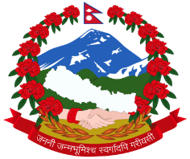
Ministry of Land Reform and Management Survey Department Minbhawan, Kathmandu
Sagarmatha Height Measurement Project (SHMP) Mr. Niraj Manandhar
Deputy Director General
Geodetic Survey Division 12.12.2017

Slide 2
Outlines
1. Background
2. Objective
3. Methodology
4. Instrument and Accessories
5. Human Resources
6. Time Schedule
7. Challenges and Obstacles
8. Conclusion

Slide 3
Background
1847: The Great Trigonometric Survey (GTS) of Survey Of India (SOI) declared height of Mt. Everest (Sagarmatha) 8778 m and as the highest peak of the world. (Ref)
The name Everest follows after the Surveyor General Colonel George Everest from SOI. (Ref)
1849/50: SOI re-measured the height of Mt. Everest (Sagarmatha) from Nepal side as 8840 m.
1954: B. L. Gulatee from SOI remeasured the height as 8848 m. (Ref)
It is the authentic height adopted by Government of Nepal till date.

Slide 4
Background
1975: Chinese State Bureau of Surveying and Mapping (SBSM) measured the height of Mt. Everest (Sagarmatha) from Chinese side as 8848.13 m. (Ref.)
1999: Prof. Brad Washburn from Boston Museum of Science, United States declared the height of Mt. Everest as 8850 m using GPS and RADAR technology. (Ref.)
2005: SBSM re-measured the peak and declared 8844.43 m as the Everest rock-height. (Ref.)
Poretti

Slide 5
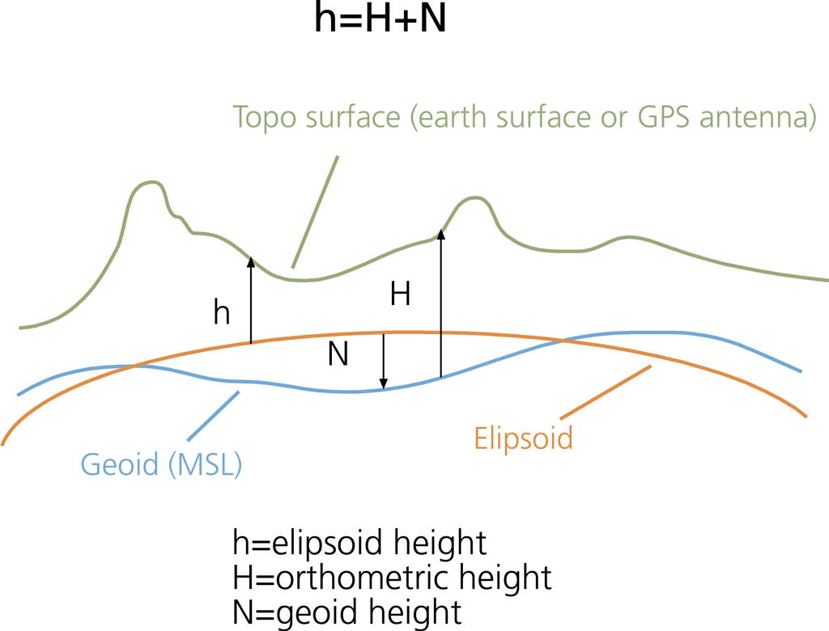
Objective
To Determine Orthometric Height of Mt. Everest (Sagarmatha)

Slide 6
Reconnaissance and Monumentation
Here will be a political map of Solokhumbhu district showing all the stations

Slide 7
Methodology
Sagarmatha Height Measurement Project (SHMP) consists of following activities
Sagarmatha Height Measurement Project (SHMP)
Workshop
Gravity Survey
G.P.S. Survey
Computation
Conference & Result Publication
Summit Observation
Literature Review
Levelling Survey
Height Verification

Slide 8
Activity 1 : Workshop
Objective
The main objective of this workshop is to discuss and finalize the methodology developed by Survey Department
Participants
National Participants
Survey Department
International Participants
International Association of Geodesy
FIG
JAXA
EvK2CNR
SOI
NSBM
Media Partners

Slide 9
Activity 2: Height Verification
Permanent Bench Mark (PBM) located at Bashghari, Udayapur district will be used as the reference point for the Sagarmatha Height Measurement Project.
Following Methods will be used to verify the height of the reference PBM.
2.1 Precise Levelling
Height verification at reference PBM:
The PBM at Betini, 10km ahead of Bashghari, will be used.
Forward and Backward Levelling will be done.
The accuracy of precise levelling will be 2 mm/km.

Slide 10
Activity 2: Height Verification
2.2 Independent Check
The tectonic/mass movement caused due to Gorkha earthquake will be computed based on GPS and gravity observation at the reference PBM.
The geometric N (n1) separation and gravimetric N separation (n2) will be computed and compared.
(Ref)
Here , n1-n2 < limit of tolerance, i.e. 50 cm
If this is within the limit, the height at the PBM at Bashghari is considered as the precise orthometric height but will carry a tolerance of (n1-n2)
With the following parameters:
R Mean earth radius γ Mean normal gravity for the earth σ The sphere of integrations S(ψ) Stokes` function
Δg Free air gravity anomalies
dσ Element of surface area on the sphere
Ψ Surface spherical radius (ψ) between two points on the sphere

Slide 11
Mt. Everest ( Sagarmatha) Observation Stations
12 possible stations for trigonometric levelling to peak of Mt. Everest ( Sagarmatha) based on preliminary report :
S. No. | Name of Peak | District/ VDCs | Latitude | Longitude | Height (m) | Recce and Monumentation | Remarks
1 | Upper Rauje | Solukhumbu | 27.63 | 86.62 | 3980 | Not Completed | Same used by SOI
2 | Lower Rauje | Solukhumbu | 27.62 | 86.61 | 3530 | Not Completed | Same used by SOI
3 | Sollung | Solukhumbu | 27.55 | 86.57 | 3020 | Completed | Same used by SOI
4 | Pike Sub | Solukhumbu | 27.49 | 86.50 | 3280 | Completed | Same used by SOI
5 | Chhulyamu | Solukhumbu | 27.45 | 86.60 | 3050 | Completed | Same used by SOI
6 | Aisyalukharka | Solukhumbu | 27.38 | 86.73 | 2220 | Not Completed | Same used by SOI
7 | Laure Danda | Khotang | 27.35 | 86.91 | 3330 | Completed | Same used by SOI
8 | Mayam | Bhojpur | 27.30 | 87.01 | 3260 | Not Completed | Same used by SOI
9 | Taksindu | Solukhumbu | 27.60 | 86.61 | 3130 | Not Completed | New Point
10 | Pattale Danda | Solukhumbu | 27.39 | 86.55 | 3140 | Completed | New Point
11 | Jiri-I | Dolakha |  |  |  | Not Completed | New Point
12 | Jiri-II | Dolakha |  |  |  | Not Completed | New Point

Slide 12
Activity III : Levelling
Precise Levelling
Precise Levelling route will be carried from Basghari PBM, Udaypur to Pattale Danda H.S. , Chuulyamu, Taksindu H.S. , and Pike Subsidiary H.S , Solukhmubhu.
Adopted accuracy of the precise levelling will be 3 mm per 2 km
B. Trigonometric Levelling
Trignometric Levelling will be carried out to transfer the heights from 4 precisely levelled stations ( Pike, Pattale Danda, Takshindu, Chuulyamu) to remaining 8 stations.
Horizontal and vertical angles as well as inter-station distances between 12 stations will be measured to solve the trigonometric network
Mt. Everest (Sagarmatha) will be targeted from these 12 stations to get the trigonometric height.
Vertical/Zenithal angle will be observed to transfer the height to the peak of the Mt. Everest (Sagarmatha).

Slide 13
Activity IV : Gravity Survey
Surface Gravity observation will be carried out to re-define the Geiod model
Phase I :
1. Base Gravity Stations:
The base gravity station will be estabablished at PBM of Bansghari carried out from the absolute gravity station at Biratnagar.
Relative to this base gravity station at Bansghari, approximately 18 other base stations will be established at PBMs (about every 10 kms ) along the levelling routes .
2. Gravity in-fill stations at PBM
Gravity observations at PBM ( every 2 km) in between the base gravity station will be done along the levelling route
There will be 4 in-fill stations in between base gravity stations. Altogether, there will be approximately 68 gravity in-fill stations.

Slide 14
Activity IV : Gravity Survey
Phase II:
Gravity Observations at Everest Observation Network (Optional)
After the gravity value has been infilled in the base stations along the alignment or levelling route, work will be carried out for the gravity measurement at the Everest observations stations.
These observations stations are 12 observatory stations, 20 supplementary stations.
Note: This work is optional because the gravity survey has to be done within 24 hours/ a day hence it might not be possible to complete gravity survey for some stations at hill within a day.

Slide 15
Activity V : GPS Survey
After re-defining the Geoid Model, the orthometric height of GPS stations will be computed
Phase I : GPS Observation on PBMs
GPS observation will be carried out in PBMs (every 2km) on the leveling routes
Phase II : GPS Observation on Everest Observation Network
GPS observation will be carried out on all the 12 stations of Everest Observation Network

Slide 16
Activity VI: Summit Observation
Under this activity, following task will be carried out :
Expedition to the Summit
Trigonometric Survey
GPS Survey
Observation for Snow `Depth
Metereological Data Collection

Slide 17
1. Expedition to the Summit
A team of Sherpa will be deployed for establishment of special type of signal at the peak of the Mt. Everest ( Sagarmatha)
Survey Technical Team will be deployed to Everest Base Camp.
The signal will be of special type which will consists of both reflector and GPS Antennae .

Slide 18
2. Trigonometric Survey
Everest Observation Network
Vertical/Zenithal angle will be observed from twelve stations
3. GPS Survey
Four Stations will be continuously occupied by GPS

Slide 19
5. Meterological Data Collection & Computation
Atmospheric correction should be done on line of sight, as the observation are more than 25 k.m. far from Mt. Everest (Sagarmatha)
Temperature, Pressure and Humidity data will be collected at the time of observation at both ends as far as possible.
For these data, Survey Department will coordinate with Department of Hydrology and Meteorology.

Slide 20
Acitivity VIII: Conference & Publication of Final Results
A conference will be organized after completing all field survey, data processing and computation works for publication of result.

Slide 21
Time Schedule

Slide 22
Human Resources
Precise Levelling Survey
Required skilled Human Resource – 26
Trigonometrical Survey
Required Skilled Human Resource – 21
Gravity Survey
Required Skilled Human Resource – 8
GPS Survey
Required Skilled Human Resource – 18
Data Processing, Computaion , Evaluation & Secretariat
Required Skilled Human Resource - 8
A HUGE survey team of 81 is required

Slide 23
Instruments and Accessories
Purpose | Instruments ( Available at SD at present )
1. Precise Levelling | 1. Trimble DiNi Digital Level, Least Count: 0.10 mm 2. Leica DNA 03 Digital Level, Least Count: 0.10 mm
2. Trigonometric Levelling | 1. Wild T3 Theodolite
Purpose | Instruments ( Not available at SD at present )
1. GPS Survey | 1. GPS, Dual Frequency Geodetic Receiver
2. Gravity Survey | 1. Gravimeter, Least Count: 0.01 milligal

Slide 24
Challenges and Obstacles
Sagarmatha Height Measurement Project ( SHMP) is a complex and distinctive task
Geographical location
Difficult to access
Expensive logistics
Adverse weather conditions
Skilled human resource and experts
Availability of precise geodetic instruments
Collaboration among governmental agencies: DoHM, MoH, MoFA, Tourism Board …
24 /7 availability of resources
Notes:
Employees and field affiliate workers should work on too high mountainous, mountainous roads, including raw motor roads, cold, risky, and odd situations.
International Experts on Data Processing and Analyzing. Gravity Survey Work guidance & assistance

Slide 25
Conclusion
The measurement of the height of Mt. Everest (Sagarmatha) is a matter of pride and reputation with geographical and seasonal complexity including human resource and innovative technology as limiting factors.
The team of experts involved in SHMP should be facilitated in terms of logistics, incentives and special arrangements.
The project will complete its tasks within 2 years after the approval of working procedures and methodology from the concerned authorities.

Slide 26
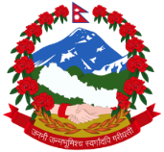
Ministry of Land Reform and Management
Survey Department
Geodetic Survey Division
Minbhawan, Kathmandu
Thank you

